Slide 1
Capital Bikeshare Analytics
Ben Cook, 21 feb. 2017

Slide 2
Overview
Capital Bikeshare is just what it sounds: a point-to-point bicycle rental service in the DC metro area
408 stations in DC, MD, VA
Users pay based on duration of trip => most trips are short
Popular with commuters
Questions of interest
Limits of capacity (stations filling up, running out)
Need to re-balance directional traffic by trucking bikes to depleted stations

Slide 3
Data
Data from Capital Bikeshare:
List of stations
latitude & longitude, capacity
XML format
Anonymous trip data (start & end stations & times)
CSV format, one file per quarter year
Analyzed 2014-2016 (963 MB csv)
Mostly used DC because of DEM for elevation & visualization
Auxiliary data:
Digital Elevation Model (1-meter LIDAR scan of DC)
Single GeoTIFF: 326 MB
Read with GDAL
Coordinate transform with PyProj (Proj.4 wrapper)
Had to define Maryland State Plane map projection
Lambert Conformal Conic with defined parameters
Not in standard Proj.4 WKT projection list
WMATA (metro) rail station locations
Download through URL API
JSON format
Daily weather (NOAA)
Web request
CSV format

Slide 4
Tools
Python 2.7
Matplotlib / Seaborn
Pandas
GDAL
PyProj / Proj.4
Simplejson
Numpy
For further analysis:
Spark GraphX
Scikit-learn

Slide 5
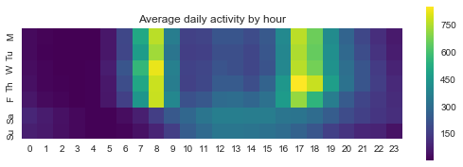
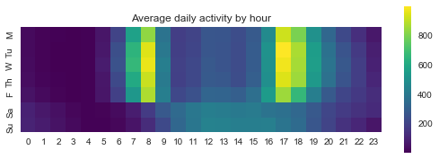
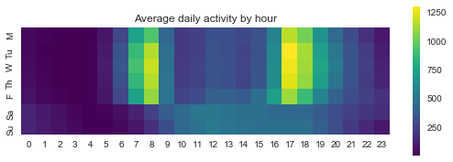
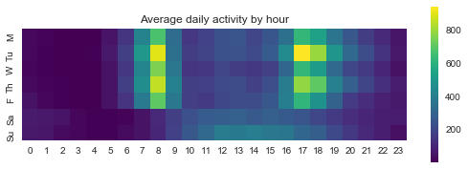
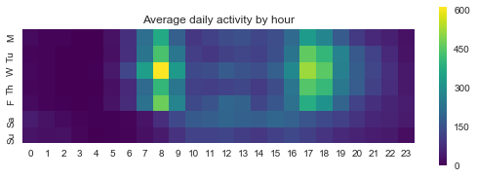
Average weekly usage
Average usage
Daily Precip > 0
High Temp. > 85°F
Higher than average
Daily Wind > 15 mph
High Temp. < 40°F

Slide 6
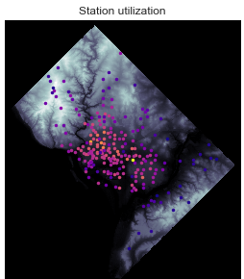
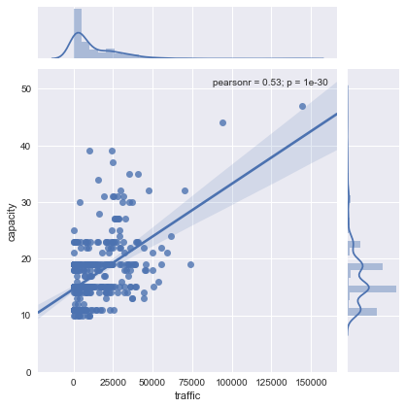
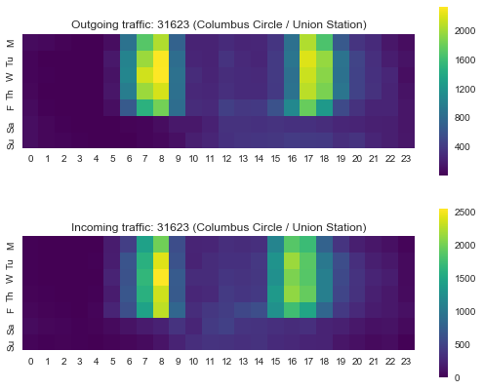
Station Utilization
Traffic – capacity relationship
Union Station
(WMATA, AMTRAK)
Yellow = high, violet = low
(square-root scale)

Slide 7
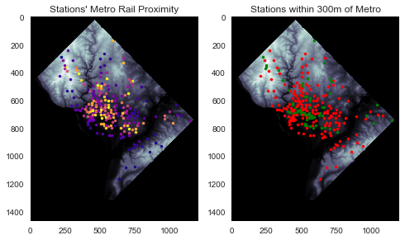
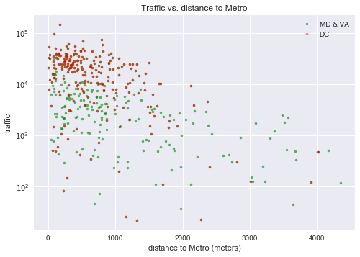
Metro proximity
Yellow = high, violet = low
Sigmoidal scale
Green: < 300 meters

Slide 8
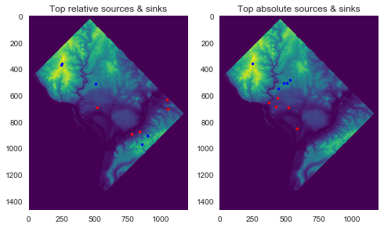
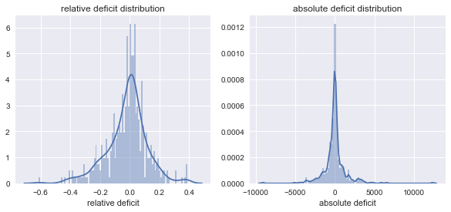
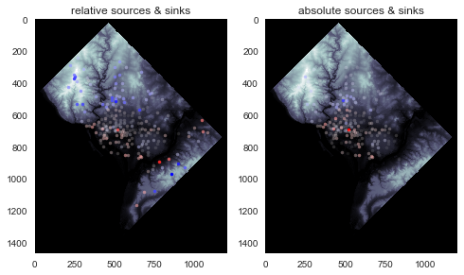
Bicycle Flux
Absolute flux: bikes arriving – bikes departing
Relative flux: absolute / total trips
Sources tend to be high elevation
Sinks tend to be low elevation

Slide 9
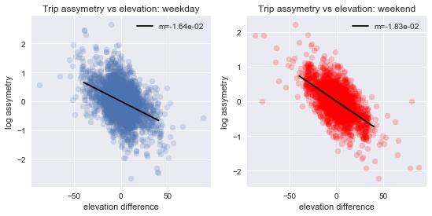

Assymetric traffic by route
$$log\left(\frac{a→b}{b→a}\right)$$
Riders clearly prefer downhill rides
Weekend and weekday riders show similar behavior
Data seems to suggest more than one trend at play
Trips to metro may be less sensitive
Trips between metro stations may be more sensitive

Slide 10
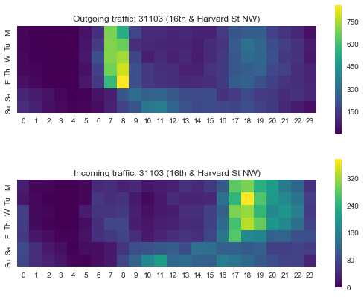
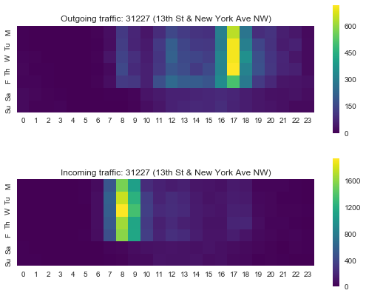
Largest Absolute Source & Sink
Source: 16th & Harvard
Sink: 13th & New York

Slide 11


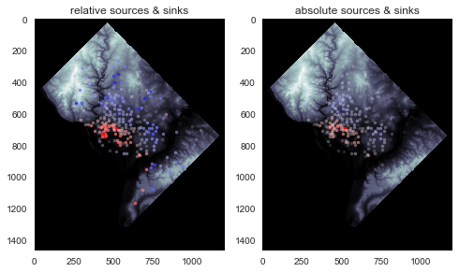
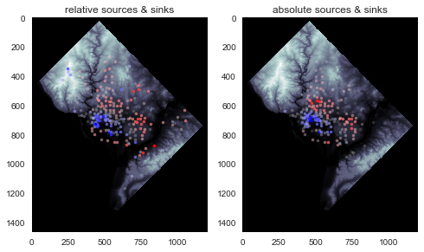
Rush Hour Patterns
Morning
Afternoon

